Slide 1
Survey on replication techniques for distributed systems
Presented By:
Alekhya Vanga

Slide 2
INTRODUCTION
REPLICATION IMPORTANCE
REPLICATION TECHNIQUES
CONCLUSION

Slide 3
INTRODUCTION:
In Distributed Systems , they provide access to large amounts of data and computational resources through wide range of interfaces.
Here, they are dynamic in nature.
In this faults are occurred more likely because of increase in scalability and also complexity.
In replication techniques , Fault tolerance is achieved.

Slide 4
REPLICATION IMPORTANCE:
The importance of “REPLICATION” is that it enables the system to maintain more replicas to ensure the flexibility of the system
To provide higher reliability of the systems by using less reliable components , Replication is the best way to approach.

Slide 5
REPLICATION TECHNIQUES:
Read One Write All (ROWA)
Tree Quorum (TQ)
Quorum Consensus Protocol (QC)
Grid Configuration Protocol (GC)
Two Replica Distribution Technique (TRDT)
Neighbour Replica Triangular Grid (NRTG)
Neighbour Replication Distributed Technique (NRDT)

Slide 6
READ ONE WRITE ALL PROTOCOL:
ROWA protocol translates a logical read operation on a data item into one physical read on any of it’s replica.
Translates all of it’s write operation to physical writes ,one for each replica.
Concurrency controller synchronizes all of these replicas.

Slide 7
ADVANTAGES AND DRAWBACKS:
The main advantage is that it has ability to process read operation regardless of any communication failures.
Drawback is this protocol is rigid in selecting the read availability and will block all the write operations if one site is down or unreachable until the failures are repaired.
When there is an increment in response time and then automatically performance reduces.

Slide 8
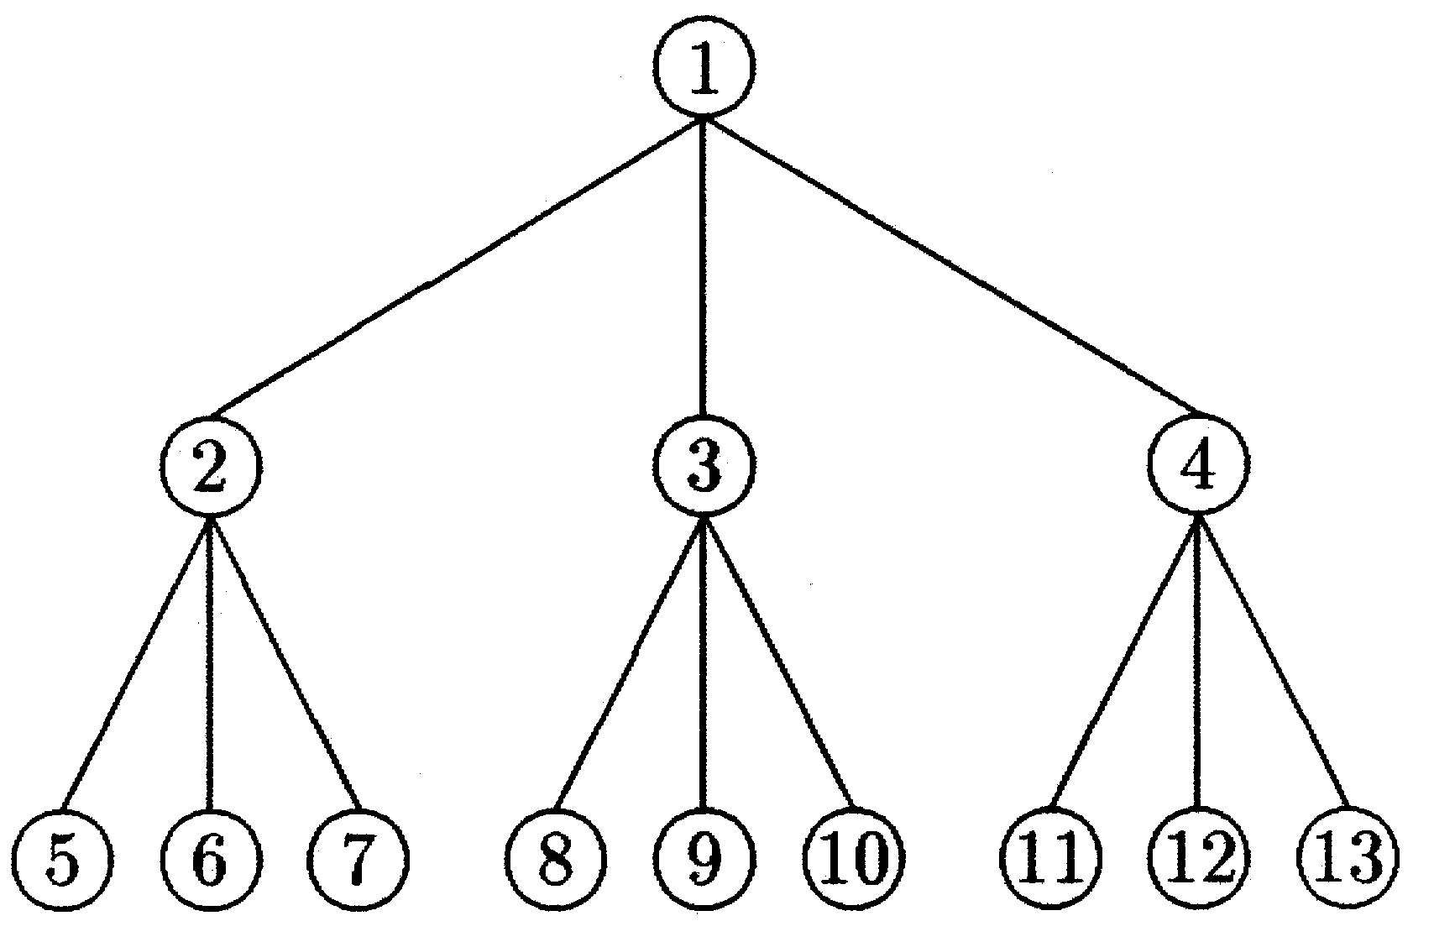
TREE QUORUM PROTOCOL:
TQ protocol was proposed by Agarwal.
Here it applies replication technique in a logical tree structure over the distributed sites.
Read and Write Quorums are needed in order to perform Read and Write operations.

Slide 9
ILLUSTRATION:
Read Quorum={1}
If node 1 fails, Read Quorum={2,3},{2,4},{3,4}
If node 2,3 fails, Read Quorum={4,5,6},{4,8,9}
If all nodes fail, Read Quorum={5,6,8,9},{6,7,9,10}
Write Quorum={1,2,3,5,6,7,9}
Write Quorum={1,2,4,5,6,11,12}

Slide 10
QUORUM CONSENSUS PROTOCOL:
Here in this QC protocol, write operation is to recorded only on subset i.e., write quorum only on a condition that
Read operation should be allowed only on a subset called “READ QUORUM”.
We have an intersection copy and that is proved specifically.
Read operation will be retrieving the most recently updated value.
Here the quorum can be of two types:
STATIC
DYNAMIC

Slide 11
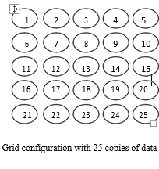
GRID CONFIGURATION PROTOCOL:

Slide 12
GC PROTOCOL & DRAWBACKS:
This Protocol introduced by MAEKAWA.
Quorum defined as the minimum number of votes that a distributed transaction has to obtain in order to allow to perform an operation in a distributed system.
It uses distributed mutual exclusion algorithm and there is a need of read and write quorum.
Read quorum={1,2,3,4,5}
Write quorum={1,6,11,16,21,7,13,19,25}
DRAWBACKS:
Communication structure cost will be high.
Grid will be prone to failure while the number of copies of read and write quorum is large.

Slide 13
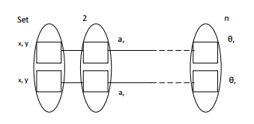
TWO- REPLICA DISTRIBUTION TECHNIQUE(TRTD):
All the objects present within the environment will have two replicas.
Uses Asynchronous Replication technique.
Store and forward approach to data backup or data protection.

Slide 14
TWO- REPLICA DISTRIBUTION TECHNIQUE(TRTD):
ADVANTAGES:
Equal storage capacity
Disadvantages :
Double up the resources even when the availability is not trivial.
Terminates the operation if the set is unavailable.
Faults will be doubled if both the replicas are lost/damaged.

Slide 15
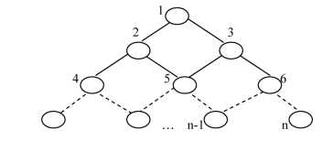
NEIGHBOUR REPLICA TRIANGULAR GRID(NRTG):
Partial Replication technique is implemented.
Nodes arranged in the form of a triangular grid structure.
Master data file associated with each node.

Slide 16
NEIGHBOUR REPLICA TRIANGULAR GRID(NRTG):
ADVANTAGES:
Low communication cost for an operation.
Applicable for large systems due to higher system availability.
Minimum storage space for nodes.
Minimum number of replication sites.

Slide 17
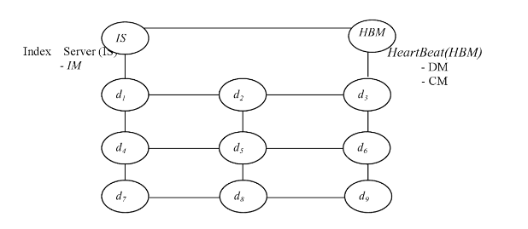
NEIGHBOUR REPLICATION DISTRIBUTION TECHNIQUE(NRDT):
Organized in the form of 2-dimensional grid structure.
Master data file associated with each node.
To improve reliability ,fault tolerance and fault recovery ,Index Server (IS) and Heart Beat Monitor(HBM) are included.

Slide 18
NEIGHBOUR REPLICATION DISTRIBUTION TECHNIQUE(NRDT):
COMPONENTS OF HEART BEAT MONITOR(HBM) :
Detection Manager
Coordination Manager
COMPONENT OF INDEX SERVER(IS):
Index Manager

Slide 19
CONCLUSION:
In order to achieve fault tolerance in a distributed system without increasing the number of reliable components, these replication techniques must be introduced in the system.

